Slide 1
Patrol Supplier Schedule
DBC- Planing
Now
No. | Content | PIC | Feb |  |  |  | Mar |  |  |  | Apr |  |  |  | May |  |  |  | Jun |  |  |  | Remark
 |  |  | 1w | 2w | 3w | 4w | 1w | 2w | 3w | 4w | 1w | 2w | 3w | 4w | 1w | 2w | 3w | 4w | 1w | 2w | 3w | 4w
1 | List check items point | Ms.Sikharin Agm
2 | Setting Organization team Patrol | Ms.Sikharin Agm
3 | Training member | Ms.Sikhain Agm
4 | Supplier information | Ms.Arporn Amgr
5 | Supplier patrol -1 1.SHIN HEUNG 2.MITSUWA KORAT | All
6 | Problem report -1 | Ms.Phornsiri
7 | Supplier patrol -2 1.TRIO 2.KORAT MATSUSHITA
8 | Supplier patrol -3 1.TAPACO KABINBURI
9 | Problem report -2 | Ms.Sikharin
10 | Progressive follow up | Ms.Sikharin
11 | Summary report | Ms.Sikharin
SHIN HEUNG
MITSUWA KORAT
TRIO
KORAT MATSUSHITA
TAPACO KIBINBURI

Slide 2
Data Summary Request Return Package Form Supplier CHT-RA
Supplier | Type Package | Package Code | Quantity Package | Quantity Pallet
GOKO | BOX | L814 | 200 | 2
GOKO | BOX | M612SP | 200 | 2
SHIN HEUNG | BOX | D510 | 1000 | 10
SHIN HEUNG | BOX | D324 | 1 | -
SHIN HEUNG | BOX | D418 | 220 | 6
SHIN HEUNG | BOX | D431 | 320 | 21
SHIN HEUNG | BOX | D606 | 600 | 4
SHIN HEUNG | BOX | BULK-D510 | 450 | 5
SHIN HEUNG | BOX | L814 | 87 | 1
SHIN HEUNG | PARTITION | D518-44 | 216 | 1
SHIN HEUNG | PARTITION | D518-145 | 65 | 1
SHIN HEUNG | PARTITION | D518-160 | 250 | 2
SHIN HEUNG | PARTITION | D412-9 | 80 | 1
SHIN HEUNG | PARTITION | D433-32 | 33 | 1
MITSUWA KORAT | BOX | D518 | 124 | 2
MITSUWA KORAT | BOX | D612 | 1100 | 10
TOTAL |  |  |  | 69 PALLET

Slide 3
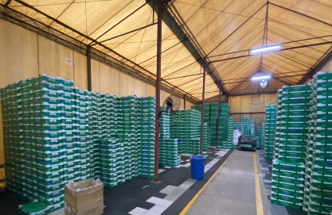
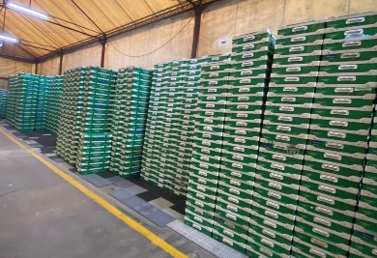
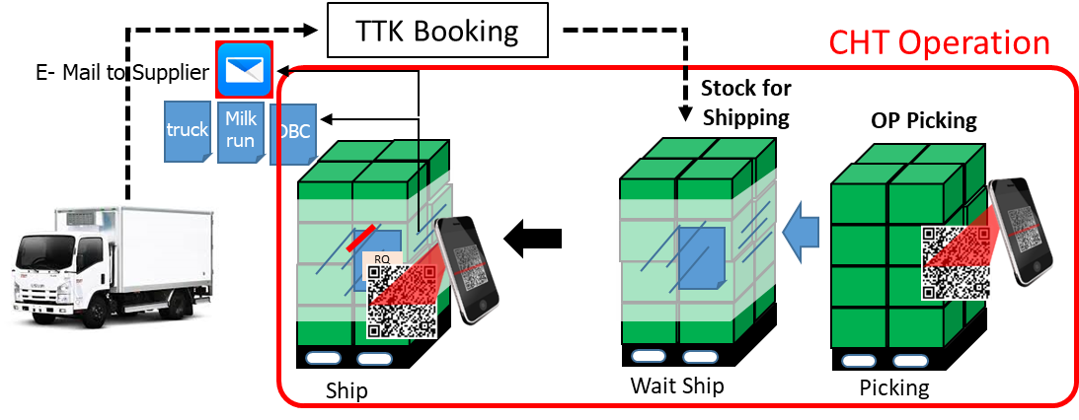
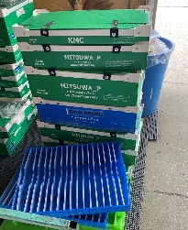
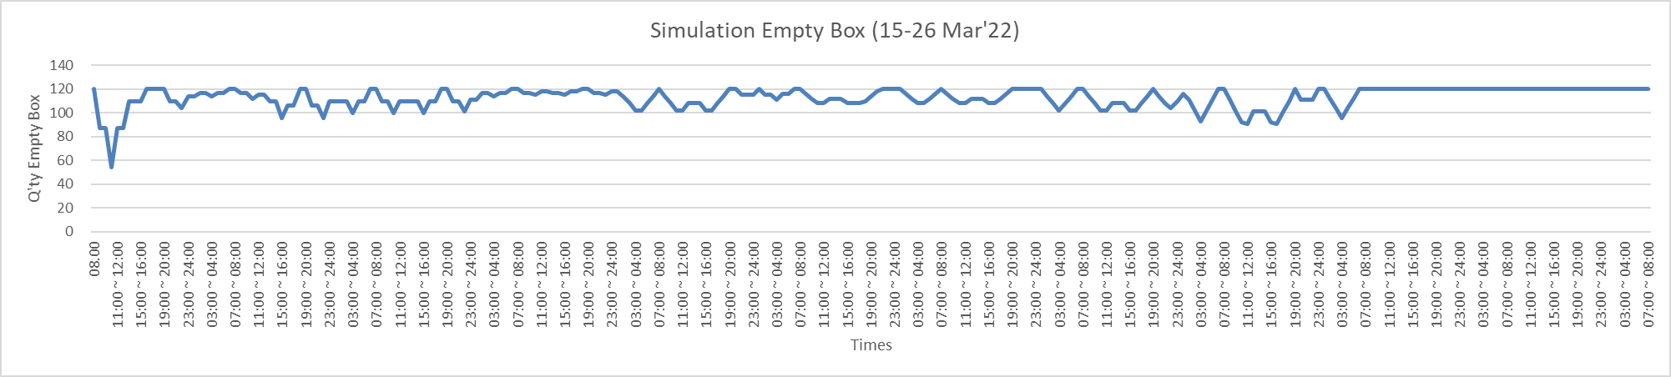
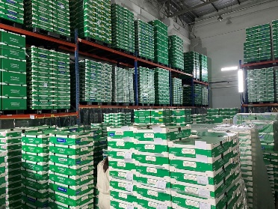
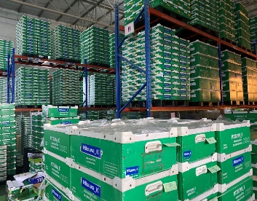
Summary patrol check supplier MITSUWA KORAT about empty box control
Issued : 21-Mar-22
Supplier’s View point
Problem | Countermeasure
Use more times to sorting empty box Empty box return un-match with their production plan Empty box return mistake supplier The work area of Supplier OK F/G | Attached QR Code (Box code & Partition code) on Box to suitable for sorting Analyze Q’ty of box (wip) and delivery cycle that suitable or not? Assy Box & Partition then delivery to supplier Step 1 ; Addition check point by leader Step 2 ; Expand to use QR Code
Stock Area of Empty Box
Work area OK F/G

Slide 4
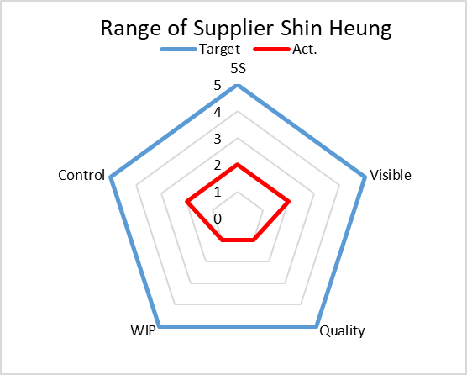
Reference : Evaluation Detail
CHT’s View point
- Supplier un-control stock of empty box
(No have stock card , Daily stock)
Detail | Rate | Target | Act.
5S | 60% | 5 | 2
Visible | 56% | 5 | 2
Quality | 40% | 5 | 1
WIP | 50% | 5 | 1
Control | 64% | 5 | 2

